Slide 1
Optimized design of metasurfaces using Deep Learning methods

Slide 2
Contents
Metasurfaces
Optimization methods
Optimization approach
Neural Networks
Implementation of the method

Slide 3
Metasurfaces

Slide 4
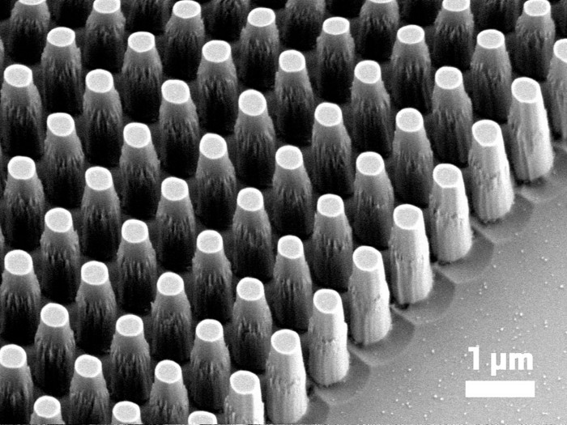
Metasurfaces
- Subwavelength-structured artificial media
- Can shape and localize electromagnetic waves in unique ways.
- Offer an extensive range of novel electromagnetic phenomena
- Which do not occur in natural materials,
- But whose existence is not restricted by the conventional materials properties.
https://planopsim.com/fabrication/an-overview-of-metasurface-fabrication
1

Slide 5
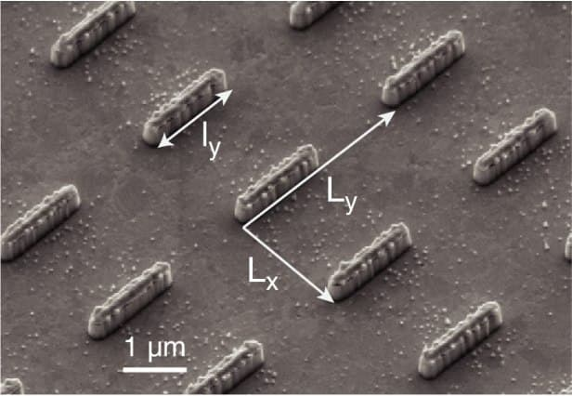
Different structures of metasurfaces
https://www.advancedsciencenews.com/metasurface-enabled-wide%E2%80%90angle-fourier-lens-video
2

Slide 6
Background
This was first theorized in 1999 by John Pendry et al:
“We show that microstructures built from nonmagnetic conducting sheets exhibit an effective magnetic permeability, which can be tuned to values not accessible in naturally occurring materials”.
3

Slide 8
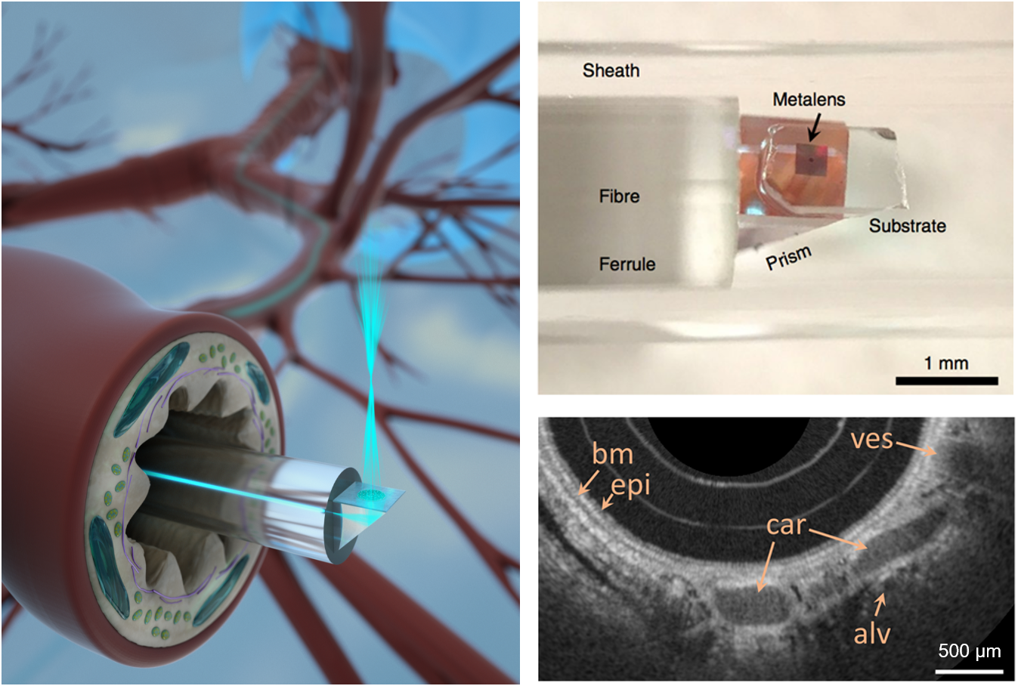
Metasurfaces and
flat optics
https://www.nature.com/articles/s41566-018-0224-2
Nano-optic endoscopes with metalenses
4

Slide 9
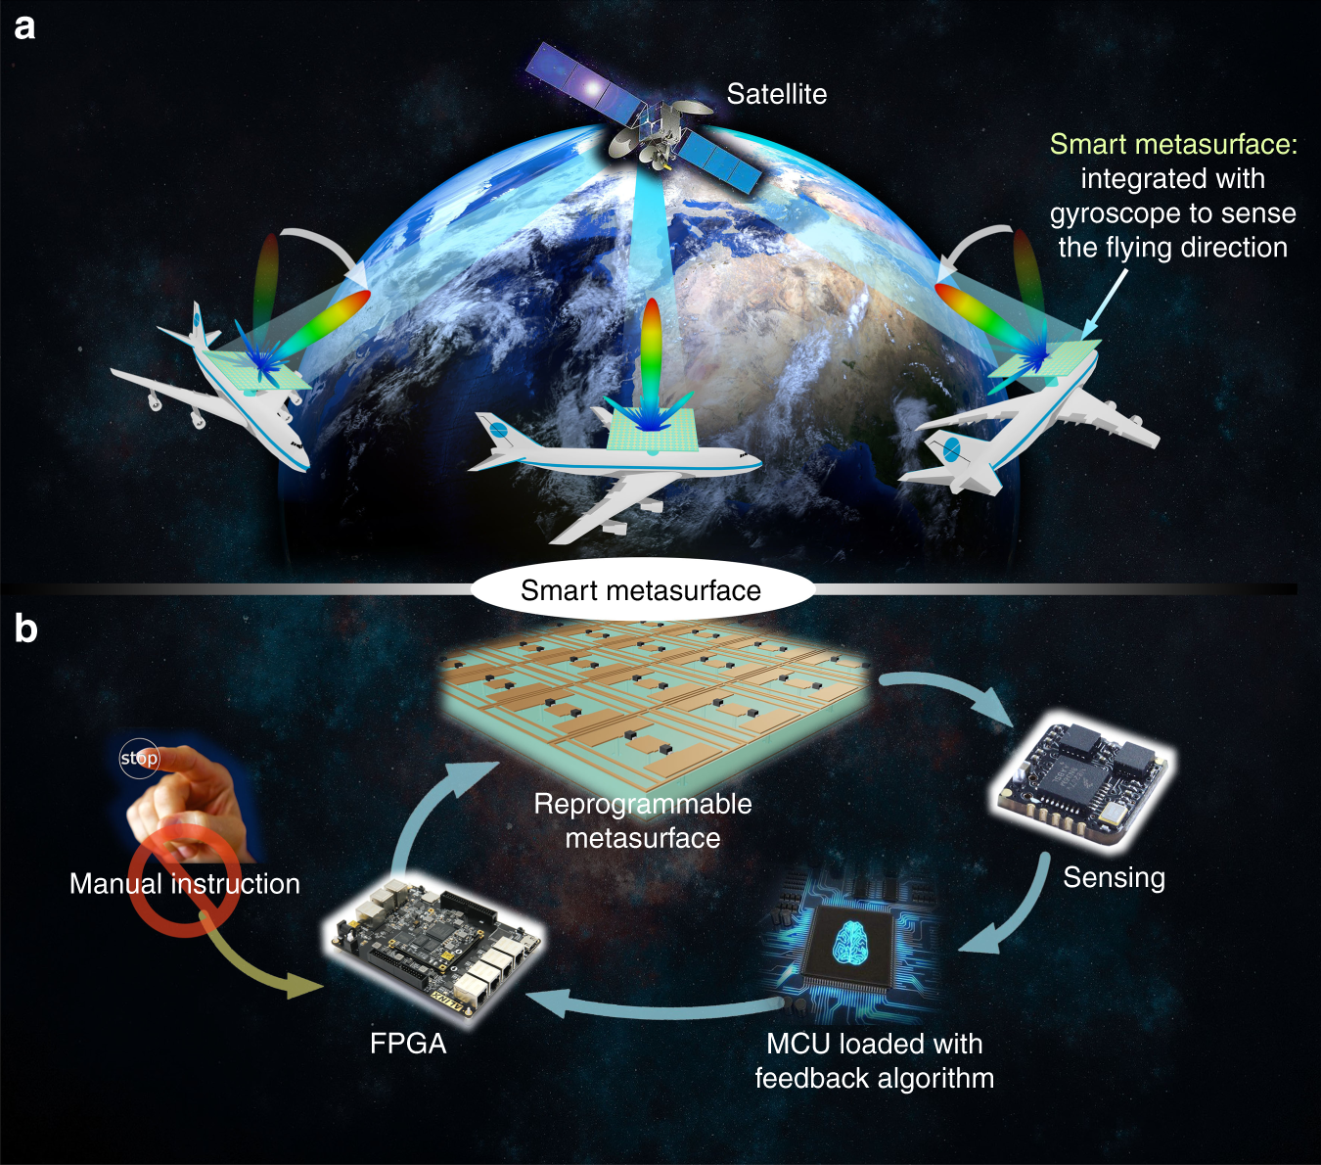
Metasurface and Smart Antennas
https://www.nature.com/articles/s41377-019-0205-3
Smart metasurface with self-adaptively reprogrammable functions
5

Slide 10
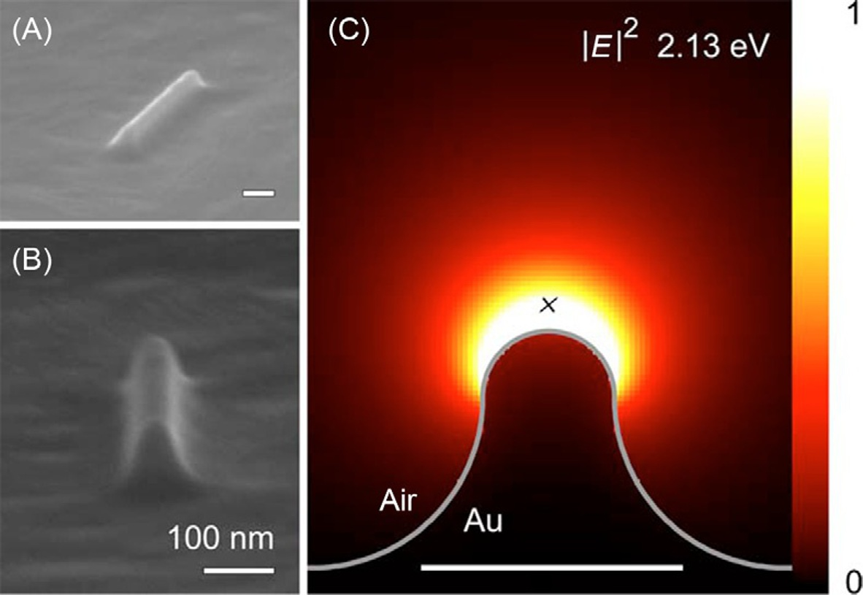
Disadvantages
https://www.elsevier.com/books/phenomena-of-optical-metamaterials/hess/978-0-12-813896-0
High losses
Strong dispersion associated with the resonant responses
Difficulty in the fabrication of nanoscale 3D structures.
590-nm-long linear ridge fabricated in a single-crystal Au substrate
6

Slide 11
Optimization Methods

Slide 12
Topology Optimization (TO)
Genetic Algorithm
A gradient-based algorithm produces freeform geometric configurations
+ Efficient in finding local optima
- Depends strongly on the initial design
Covariance Matrix Adaptation Evolution Strategy (CMA-ES)
Is an evolutionary algorithm (EA)
Can effectively deal with multi-objective optimization problems
- Is computationally expensive
- Must be used with efficient full wave solvers, especially in 3D structures
Inverse designs by Deep Learning
CMA-ES is an alternative evolutionary strategy
+ Is a self-adapted global optimization method
+ Suitable for complex problems with large parameter spaces
- Requires expensive electromagnetic solver calls
7

Slide 13
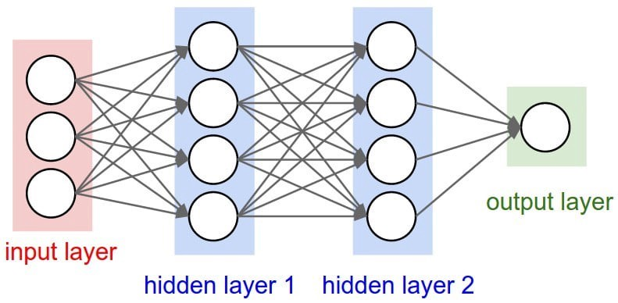
Inverse designs by Deep Learning
Artificial Neural Networks
The basic idea of neural network algorithms is to predict the solution to a problem by learning from a predefined set of examples rather than solving the problem directly.
Applications: BCI systems, AI, pattern recognition, signal processing, optimization.
9

Slide 14
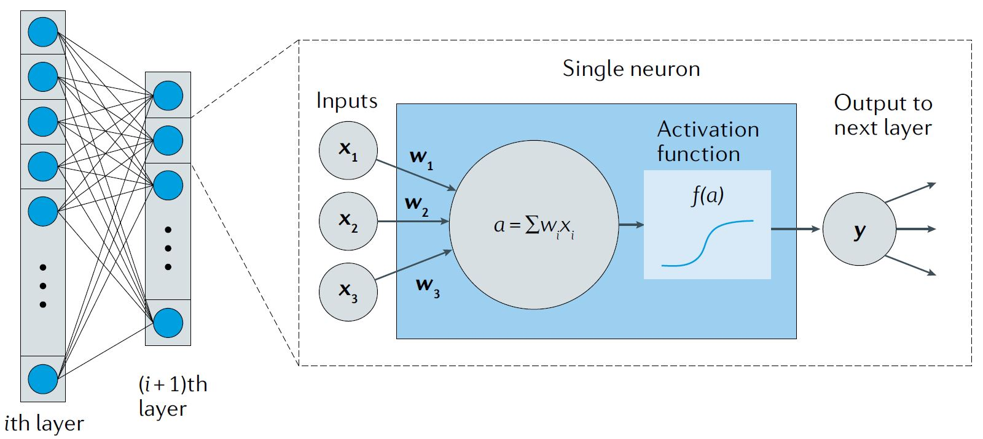
The architecture of Neural Network
Transfer function
10

Slide 15
Inverse designs by Deep Learning
Generative Adversarial Networks (GANs)
Potential to learn the relationship between structural geometry and optical response
Works with relatively less training data
- Is computationally expensive
- The training data should be preoptimized and is computationally costly to produce.
8

Slide 16
Inverse designs by Deep Learning
GLO nets
Incorporating adjoint variable calculations directly into generative neural networks. Termed Global Topology Optimization networks (GLOnets)
+ Does not require a training set of known devices
Instead learns the physical relationship between device geometry and response directly through electromagnetic simulations.
+ The trained neural network then produces new device designs at low computational cost
11

Slide 17
Inputs
Operating wavelength λ
Desired outgoing angle θ
N-dimensional noise vector z
Outputs
Refractive index profiles of the devices
Refractive index values are the design variables
13

Slide 18
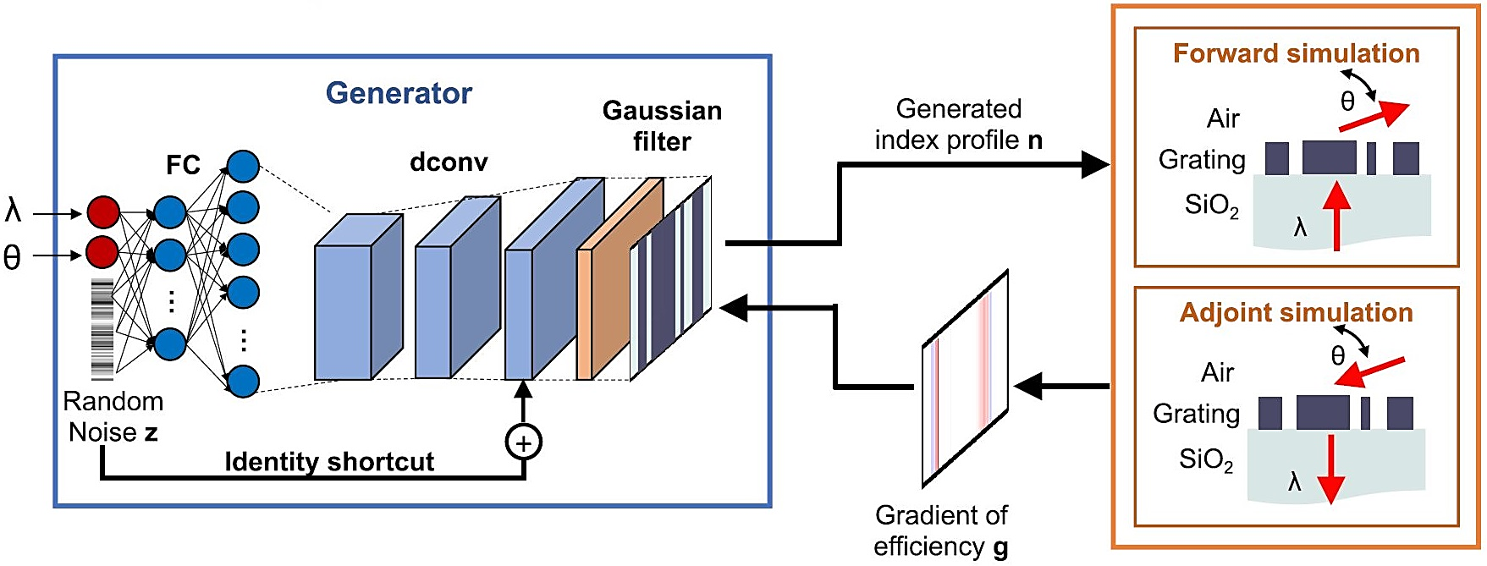
The architecture of GLOnet
https://pubs.acs.org/doi/10.1021/acs.nanolett.9b01857
14

Slide 19
Case of study
Deflection efficiency is the intensity of light deflected to the
desired direction, θ, normalized to the incident light intensity
and is governed by Maxwell’s equations.
Deflection efficiencies of the optimized devices are calculated using a rigorous coupled-wave analysis (RCWA) solver.
https://pubs.acs.org/doi/10.1021/acs.nanolett.9b01857
Task: Design of a periodic metasurface given operating:
Wavelength: 600 - 800 - 900 nm
Deflection angle: 40˚ - 80˚
Optimization objective: To maximize the
deflection efficiency of the metagrating
12

Slide 20
Optimization approach
Loss function for the conditional generator:
g(m) specifies how the device refractive indices can be
modified to improve the efficiencies
Eff(m) is directly calculated with the forward
electromagnetic simulation
Effmax(λ(m), θ(m)) is the theoretical maximum
efficiency of the globally optimal devices
16

Slide 21
The goal is generating the highest efficiency device for all possible (𝜆, 𝜃):
P_{w} is the probability of generating n in the device space
By approximating the 𝛿-function with an exponential function and using a Monte Carlo estimation:
17

Slide 22
18

Slide 23
For training and updating the network and using the chain rule: (calculated using the backpropagation)
To define the loss function 𝐿(𝐧, 𝐠, Eff):
19

Slide 24
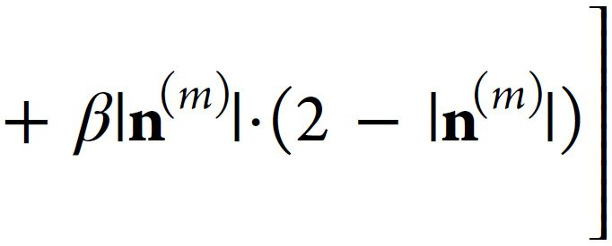
To ensure that the generated devices are binary (i.e., all silicon or air)
, which serves as a design constraint that limits metagrating efficiency,
and to balance binarization with efficiency enhancement:
20

Slide 25
The flowchart of GLO net
During network training, the objective is to iteratively optimize w to maximize the efficiencies of {n| λ, θ}
The generator, conditioned on (λ, θ), maps different z onto different device instances: n = G_{w}(z; λ, θ)
15

Slide 26
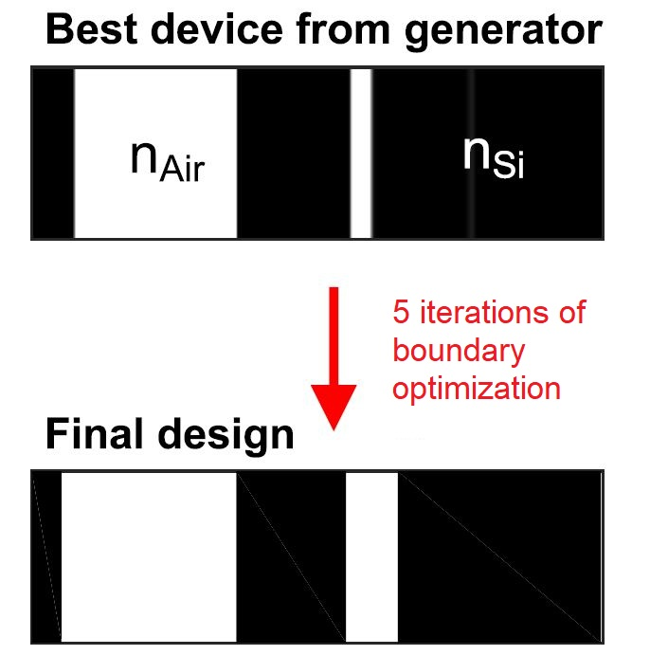
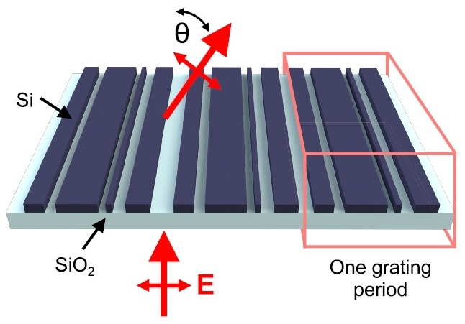
Boundary optimization
We attempt to refine the generated devices
from the conditional GLOnet using
adjoint-based boundary optimization.
We only consider the gradients at the
silicon−air boundaries of the device
and fix the device refractive indices to
be binary throughout the optimization.
21

Slide 27
Implementation of the method

Slide 28
Parameters
λ : 600 – 800 - 900 nm
Deflection angle : 40˚ - 60˚ - 70˚ - 80˚
Batch size: 100
Number of iterations : 500-1000
22

Slide 29
Deflection efficiency histograms for each pair of (λ,θ)

Slide 30
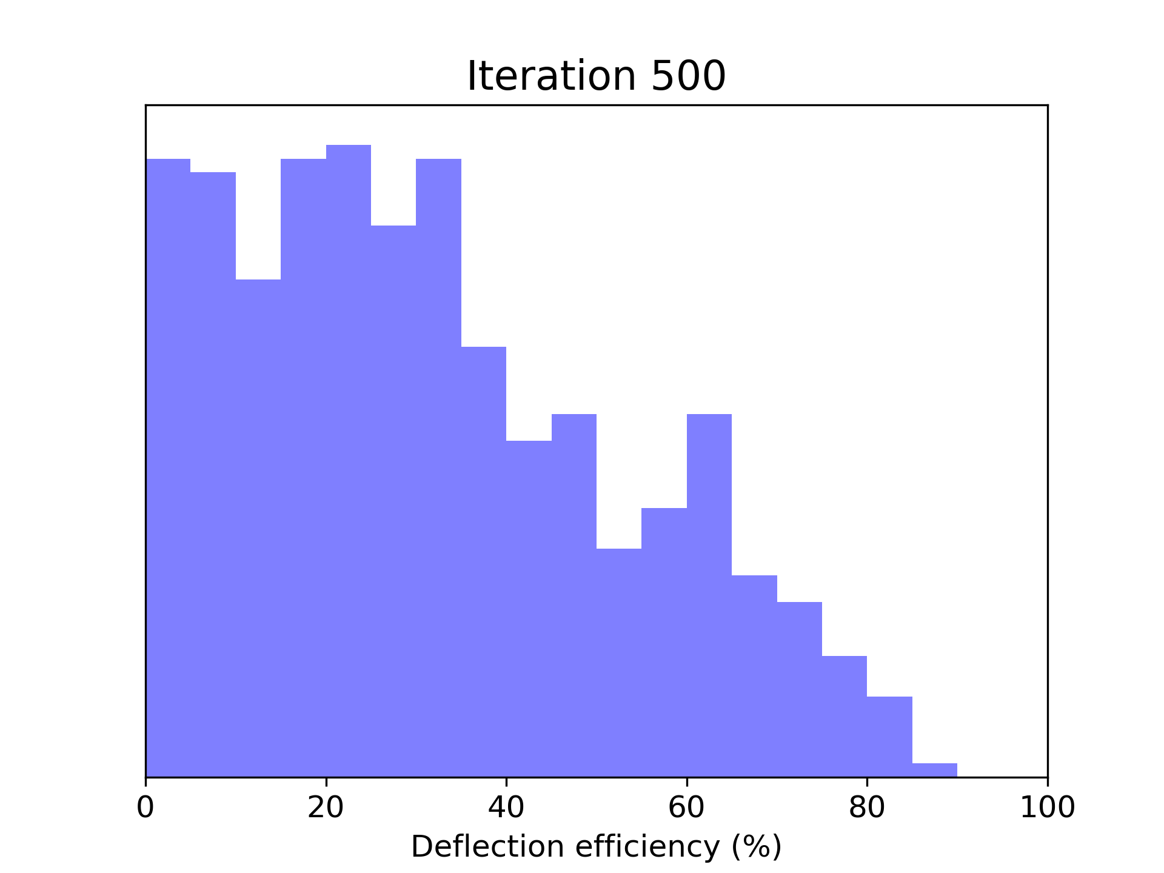
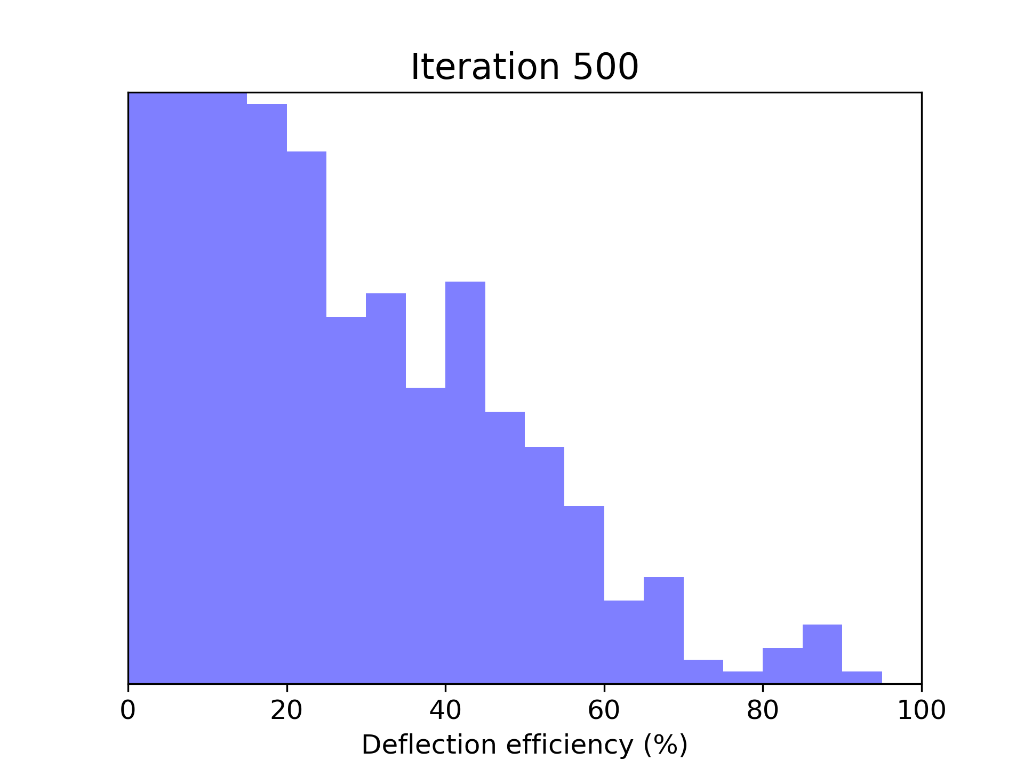
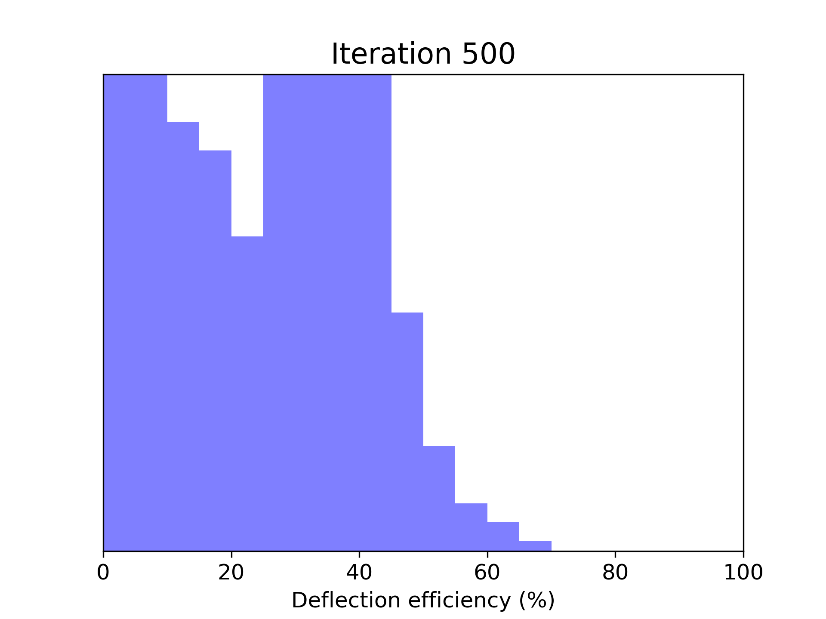
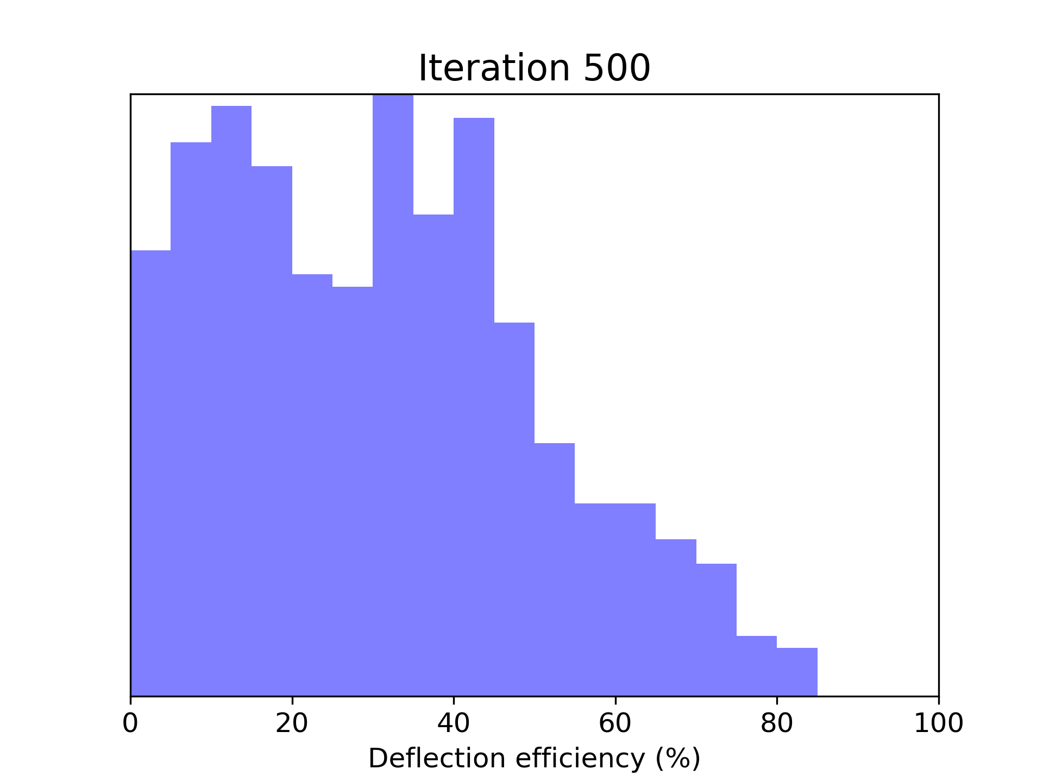
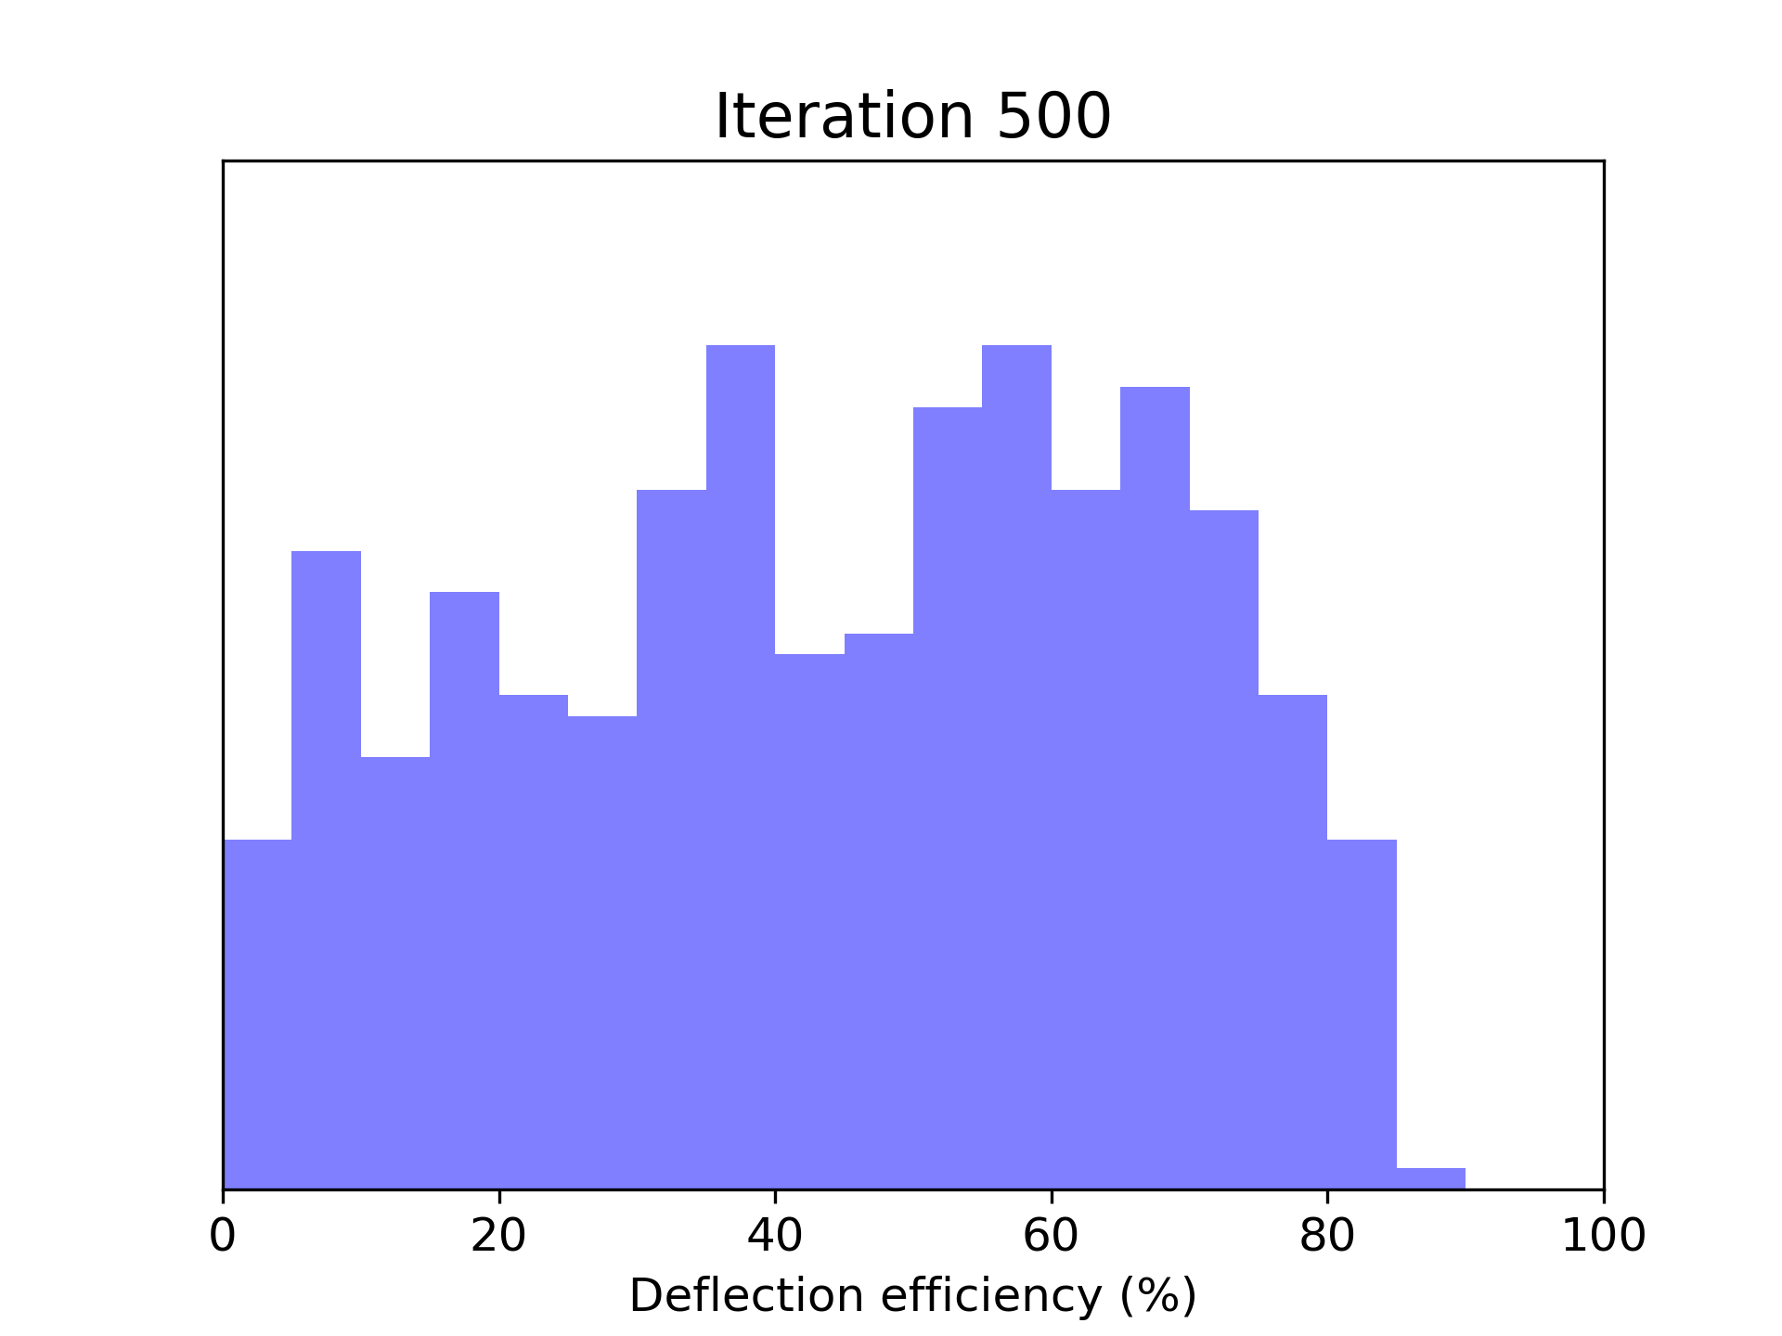
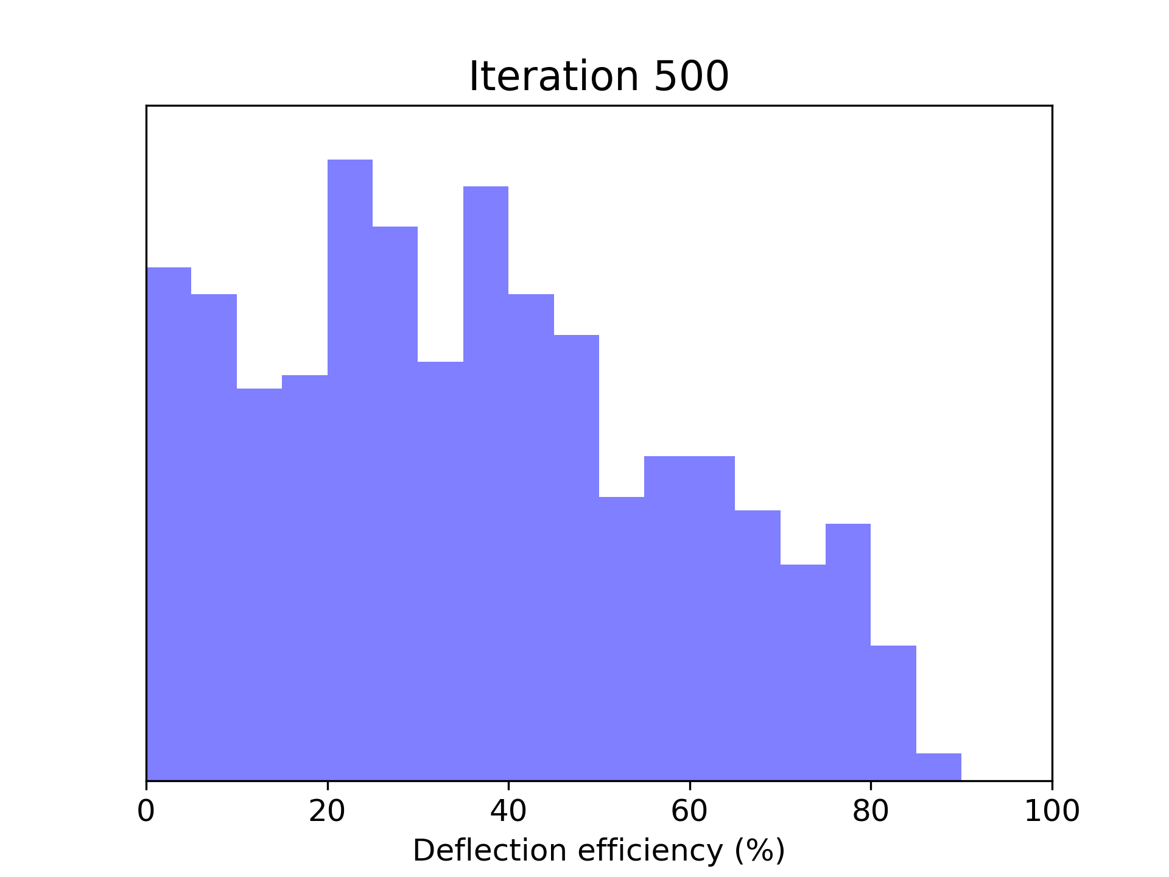
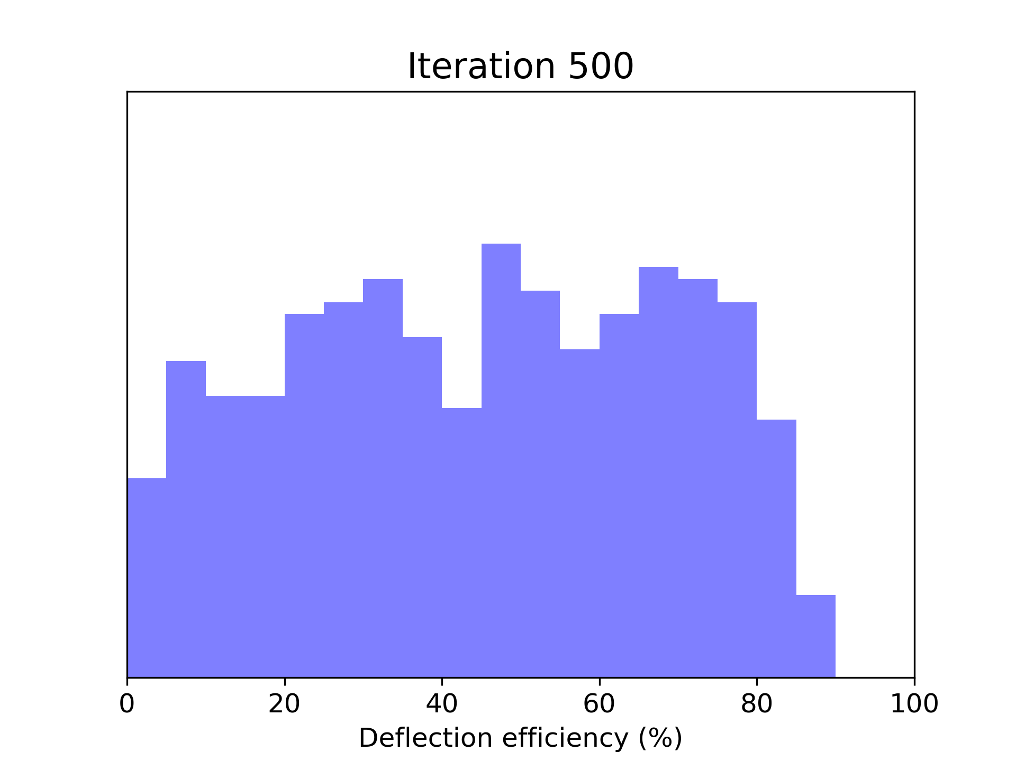
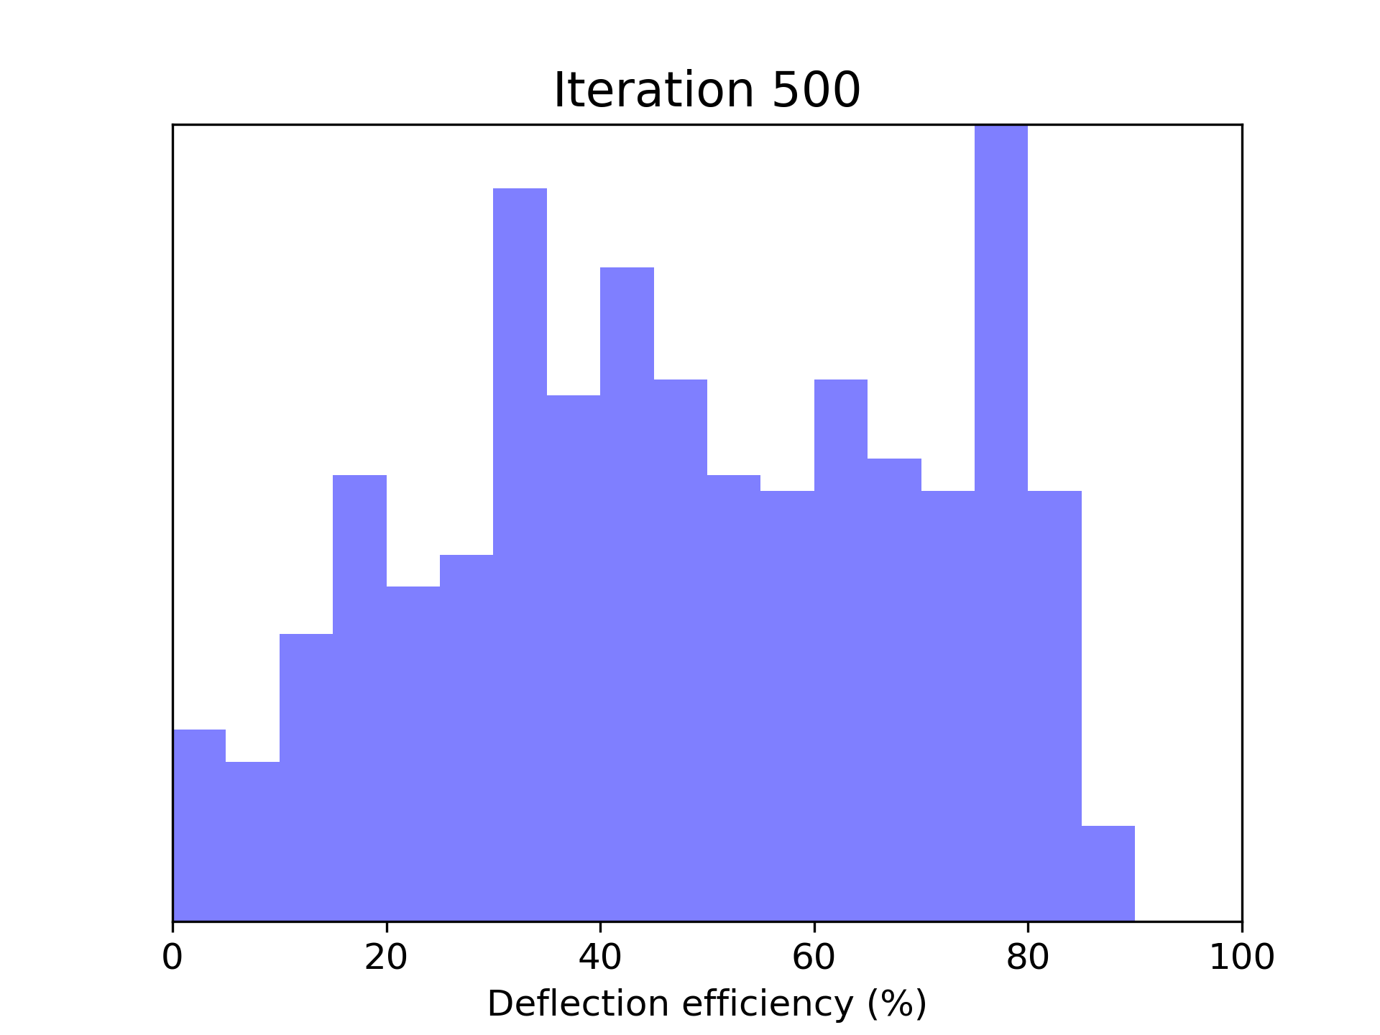
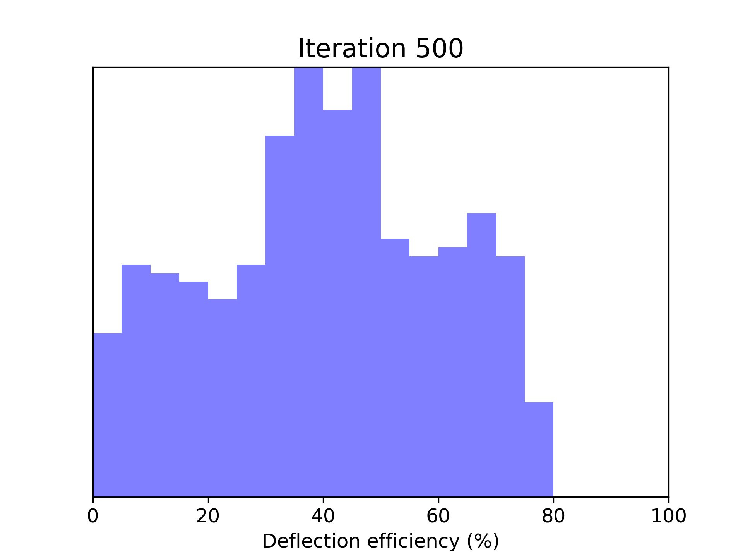
600
Wavelength (nm)
800
900
40
60
80
Deflection Angle
23

Slide 31
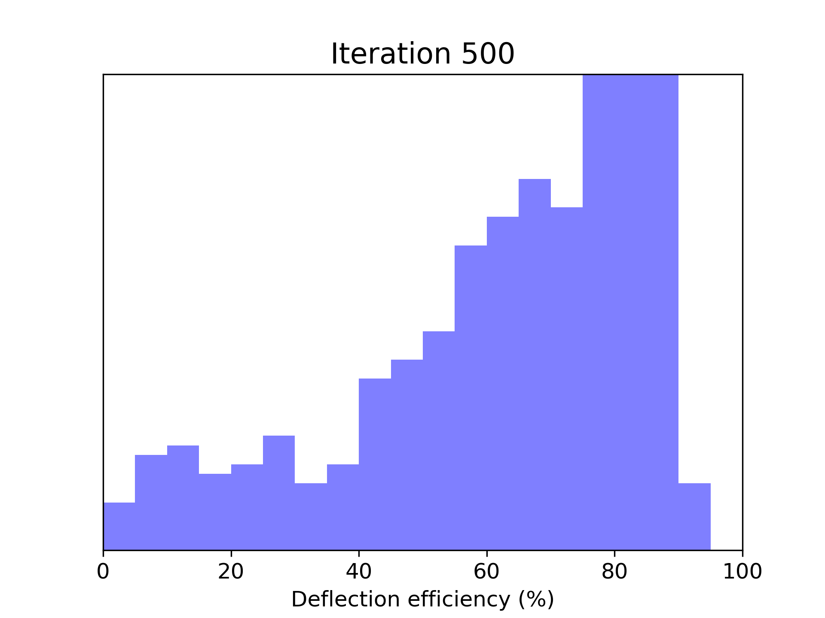
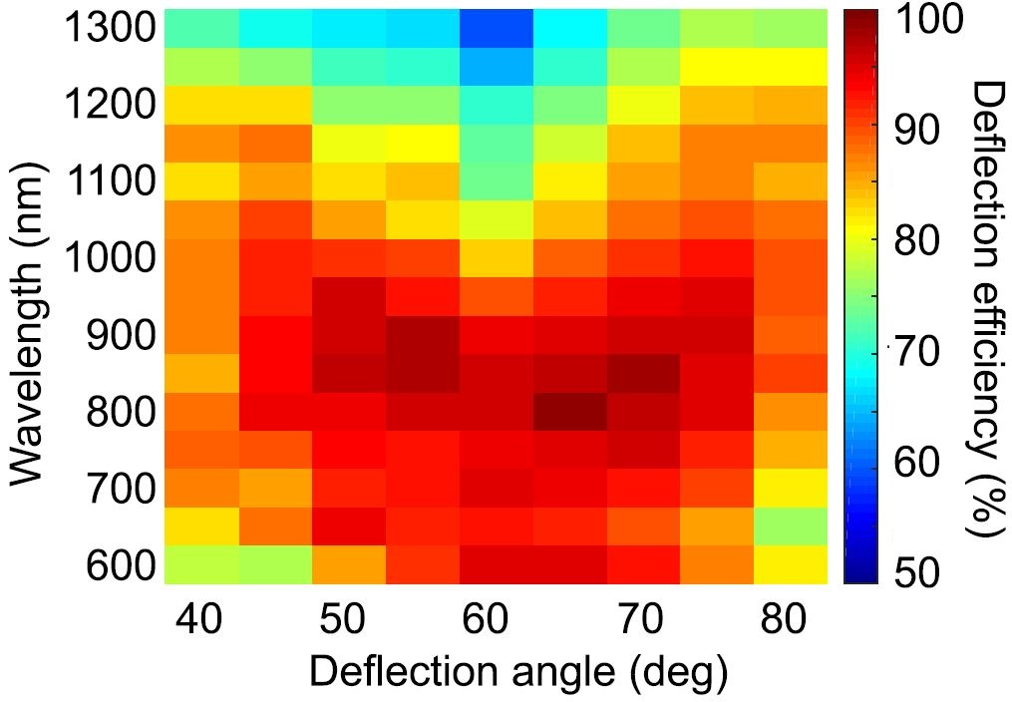
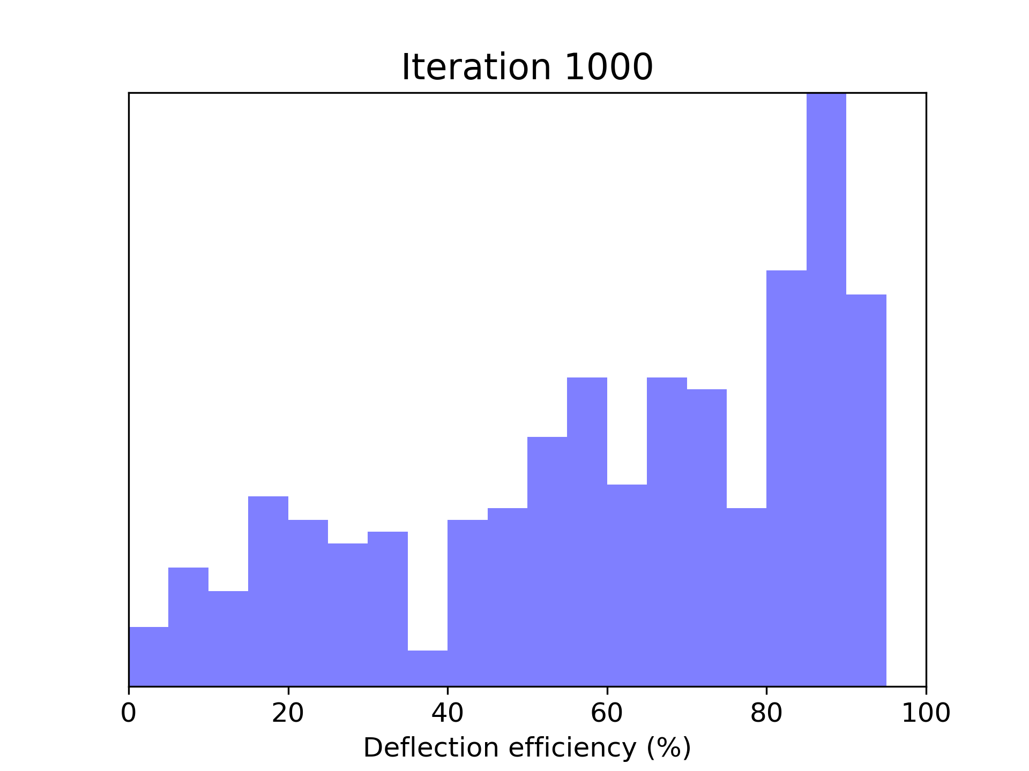
A comparison between the results
Wavelength: 900 nm
Deflection Angle: 70
24

Slide 32
Evolution of device patterns
600
It#: 500
Angle: 60
800
It#: 500
DA: 65
Wavelength (nm)
It#: 500
DA: 70
900
It#: 1000
DA: 70
25

Slide 33
Evolution of device patterns
and efficiency histograms
26

